Slide 1

Song eunyoung, Lee minji, Lee hanwool

Slide 2
01
CONTENTS
Chapter\ 1
ABOUT TEAM 2
ARCHITECTURE –ERD / CLASS DIAGRAM
FUNCTION / HOW TO USE
LIBRARY
SOURCE FILE SOLUTION
01

Slide 3

02
1
ABOUT 2
Chapter\ 1
Song eunyoung
Computer Engineering
SOURCE FILE SOLUTION
01

Slide 4

02
1
ABOUT 2
Chapter\ 1
Song eunyoung
Computer Engineering
Lee Minji
Fashion design
SOURCE FILE SOLUTION
01

Slide 5

02
1
ABOUT 2
Chapter\ 1
Song eunyoung
Computer Engineering
Lee Minji
Fashion design
Lee hanwool
Computer Engineering
SOURCE FILE SOLUTION
01

Slide 6
06
2
ARCHITECTURE –ERD/ CLASS DIAGRAM
Chapter\ 1
이름
아이디
파일이름
1
업로드
유저
N
파일
생년월일
파일번호
1
아이디
N
이메일주소
업로드시간
디테일
수정시간
SOURCE FILE SOLUTION
01

Slide 7
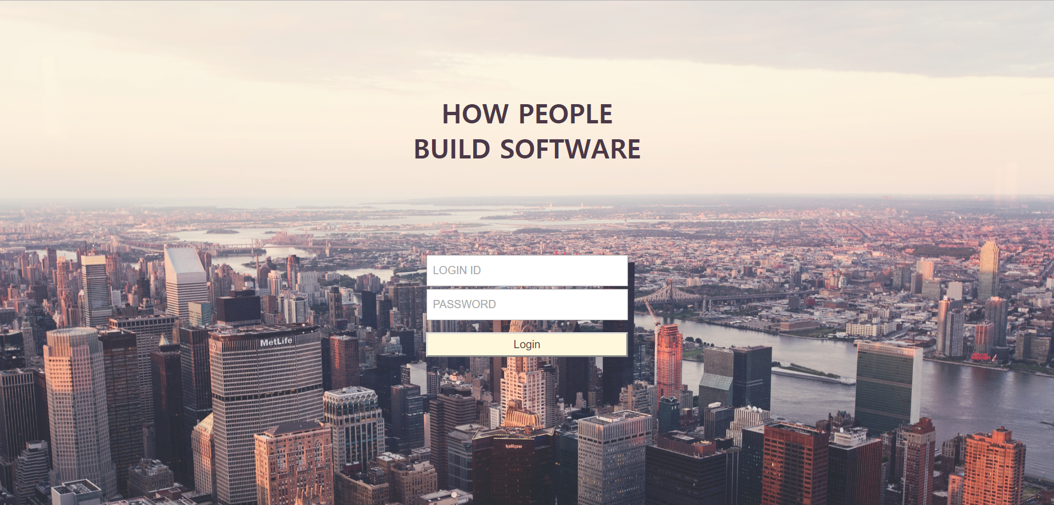
5
FUNCTION / HOW TO USE
Chapter\ 1
SOURCE FILE SOLUTION

Slide 8
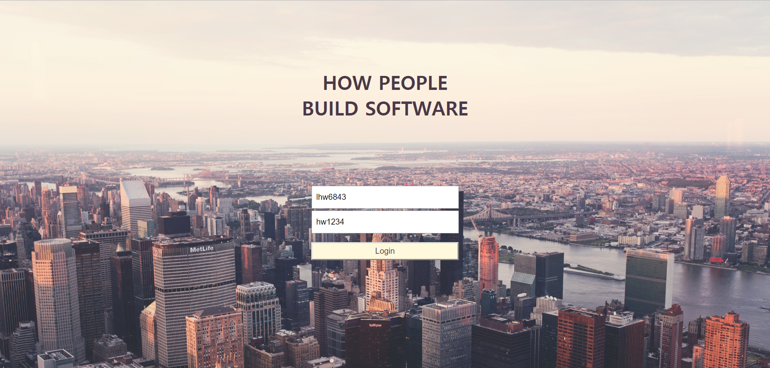
5
FUNCTION / HOW TO USE
Chapter\ 1
SOURCE FILE SOLUTION
01

Slide 9
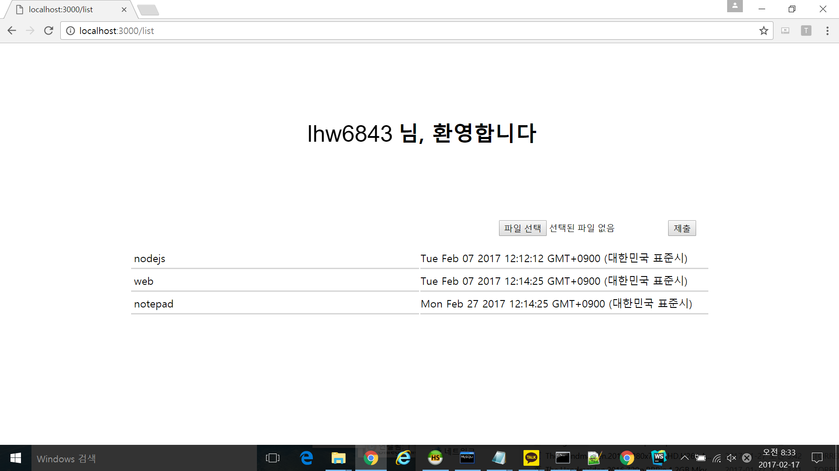
Chapter\ 1

Slide 10
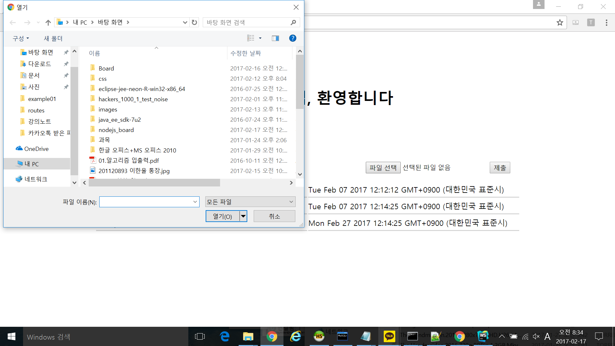
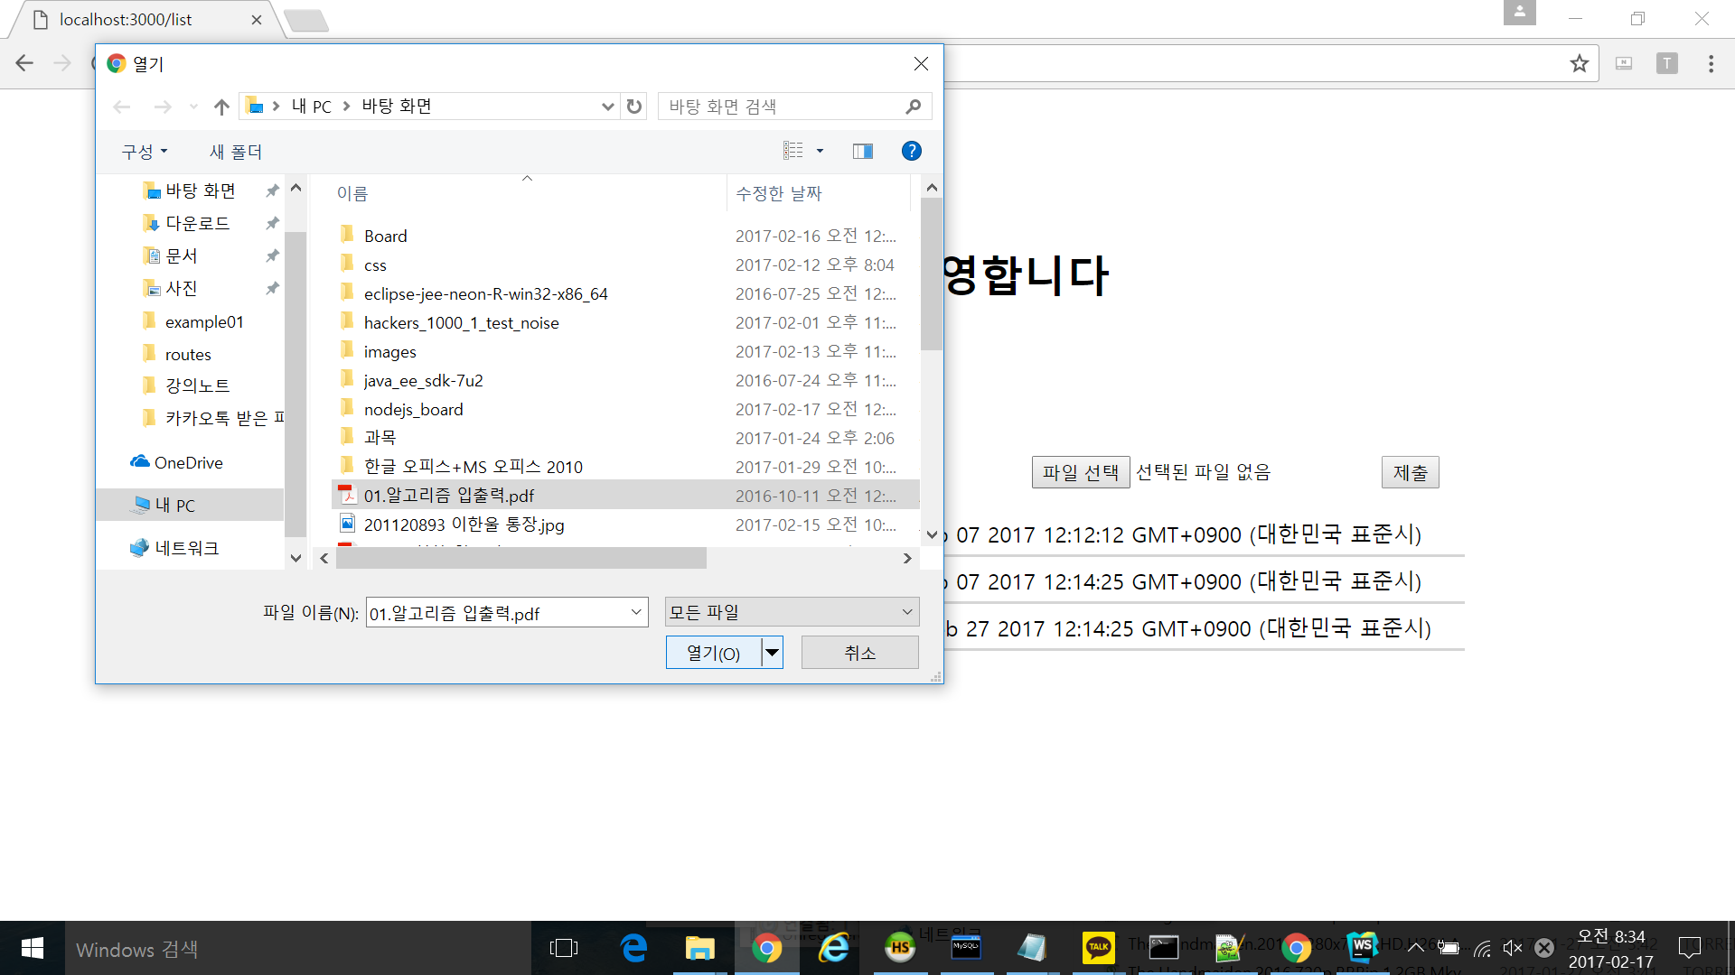
Chapter\ 1

Slide 11


Slide 12
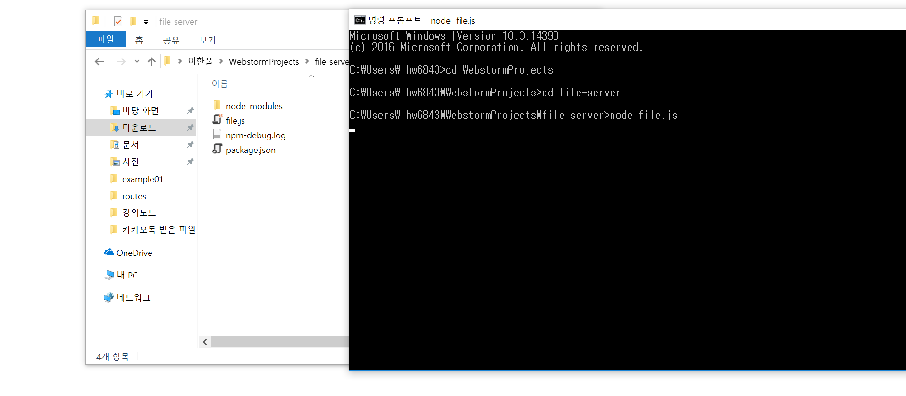

Slide 13
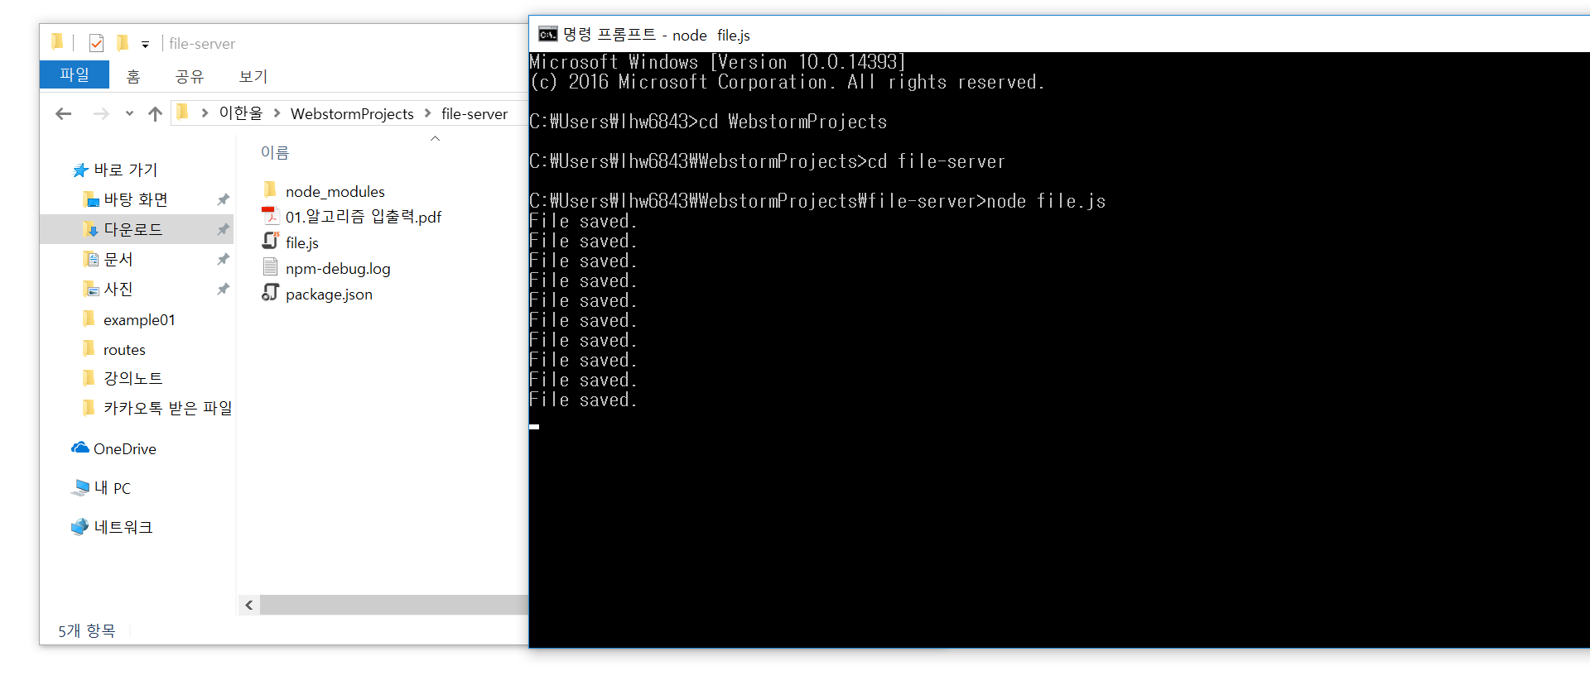

Slide 14
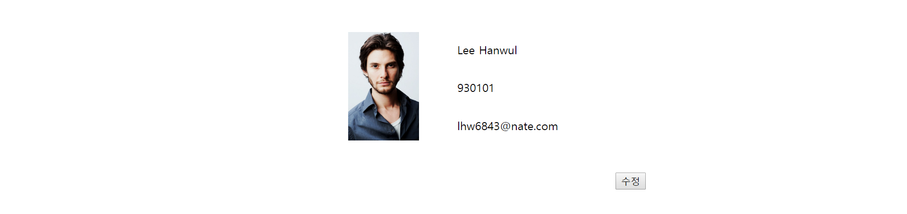

Slide 15
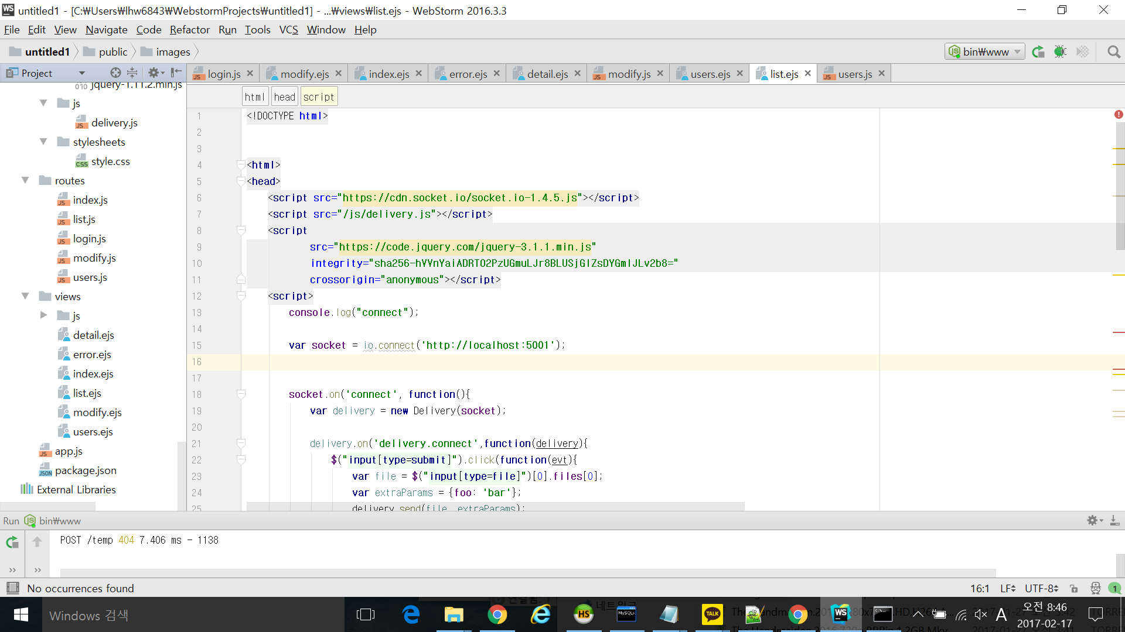

Slide 16
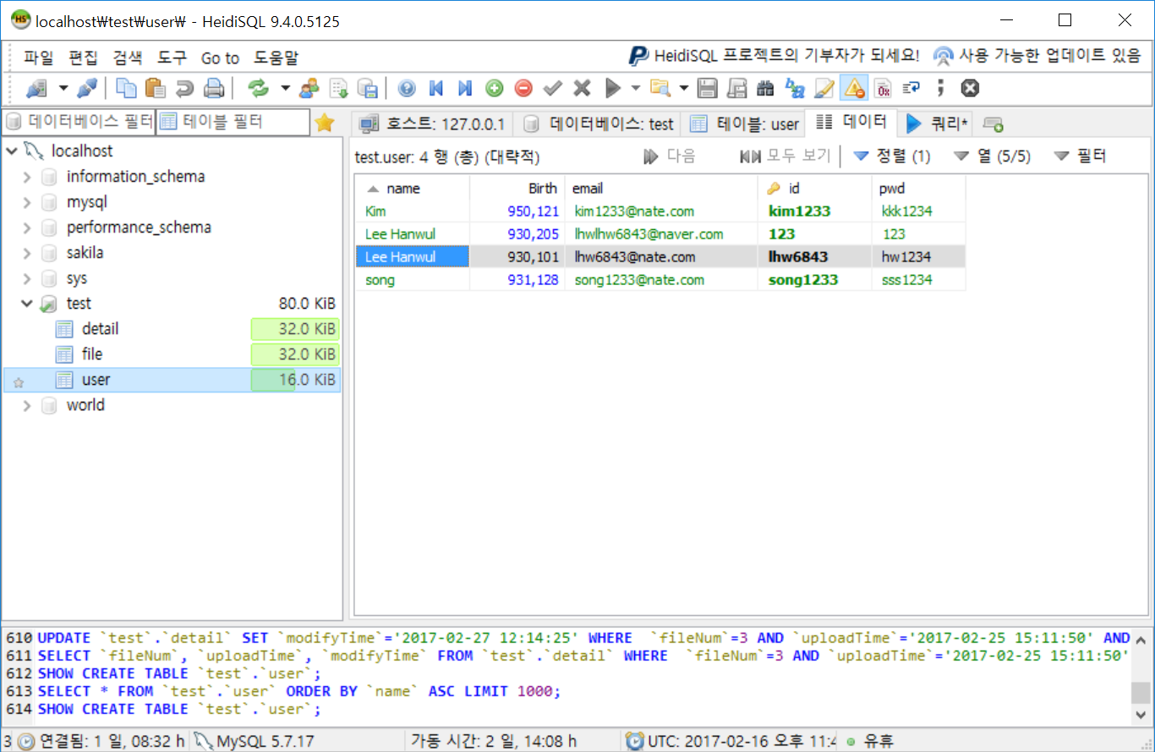

Slide 17
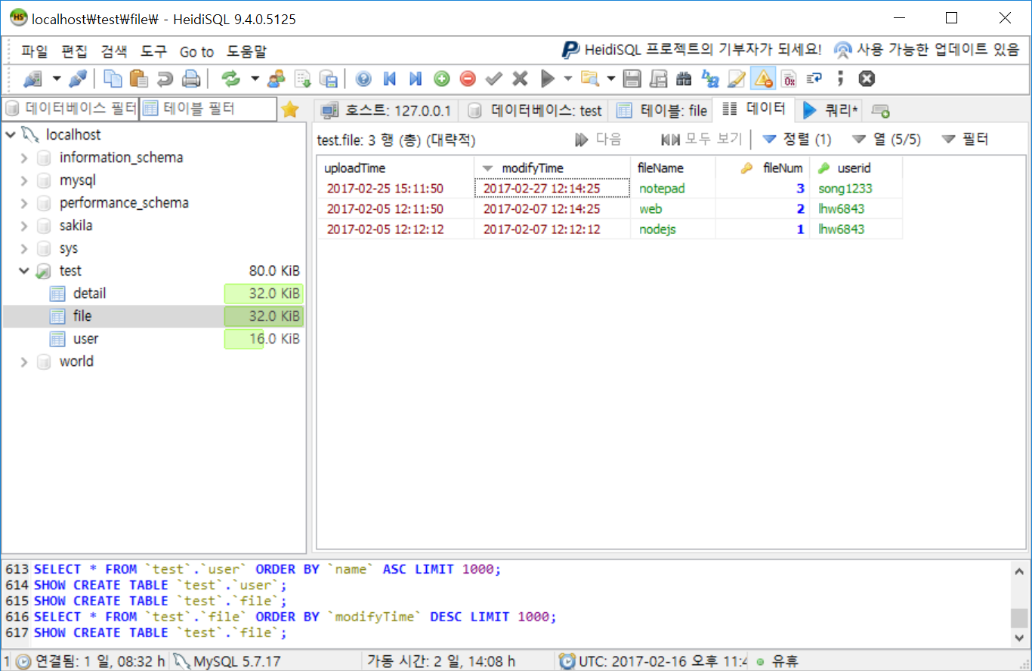

Slide 18
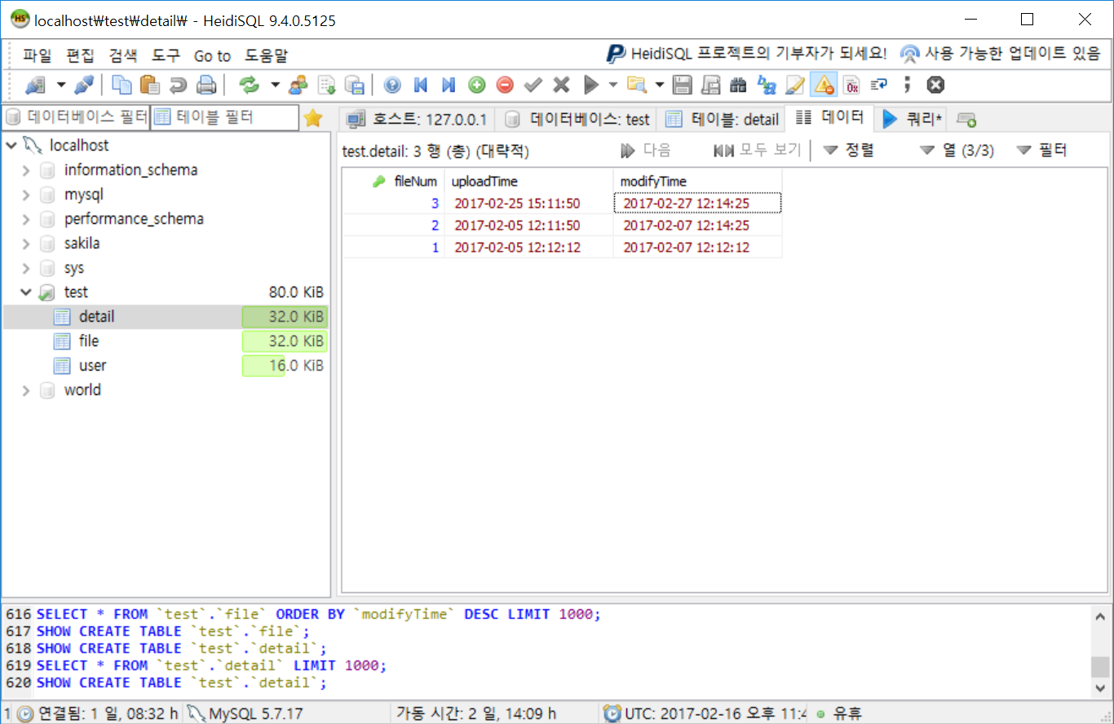

Slide 19




Slide 20
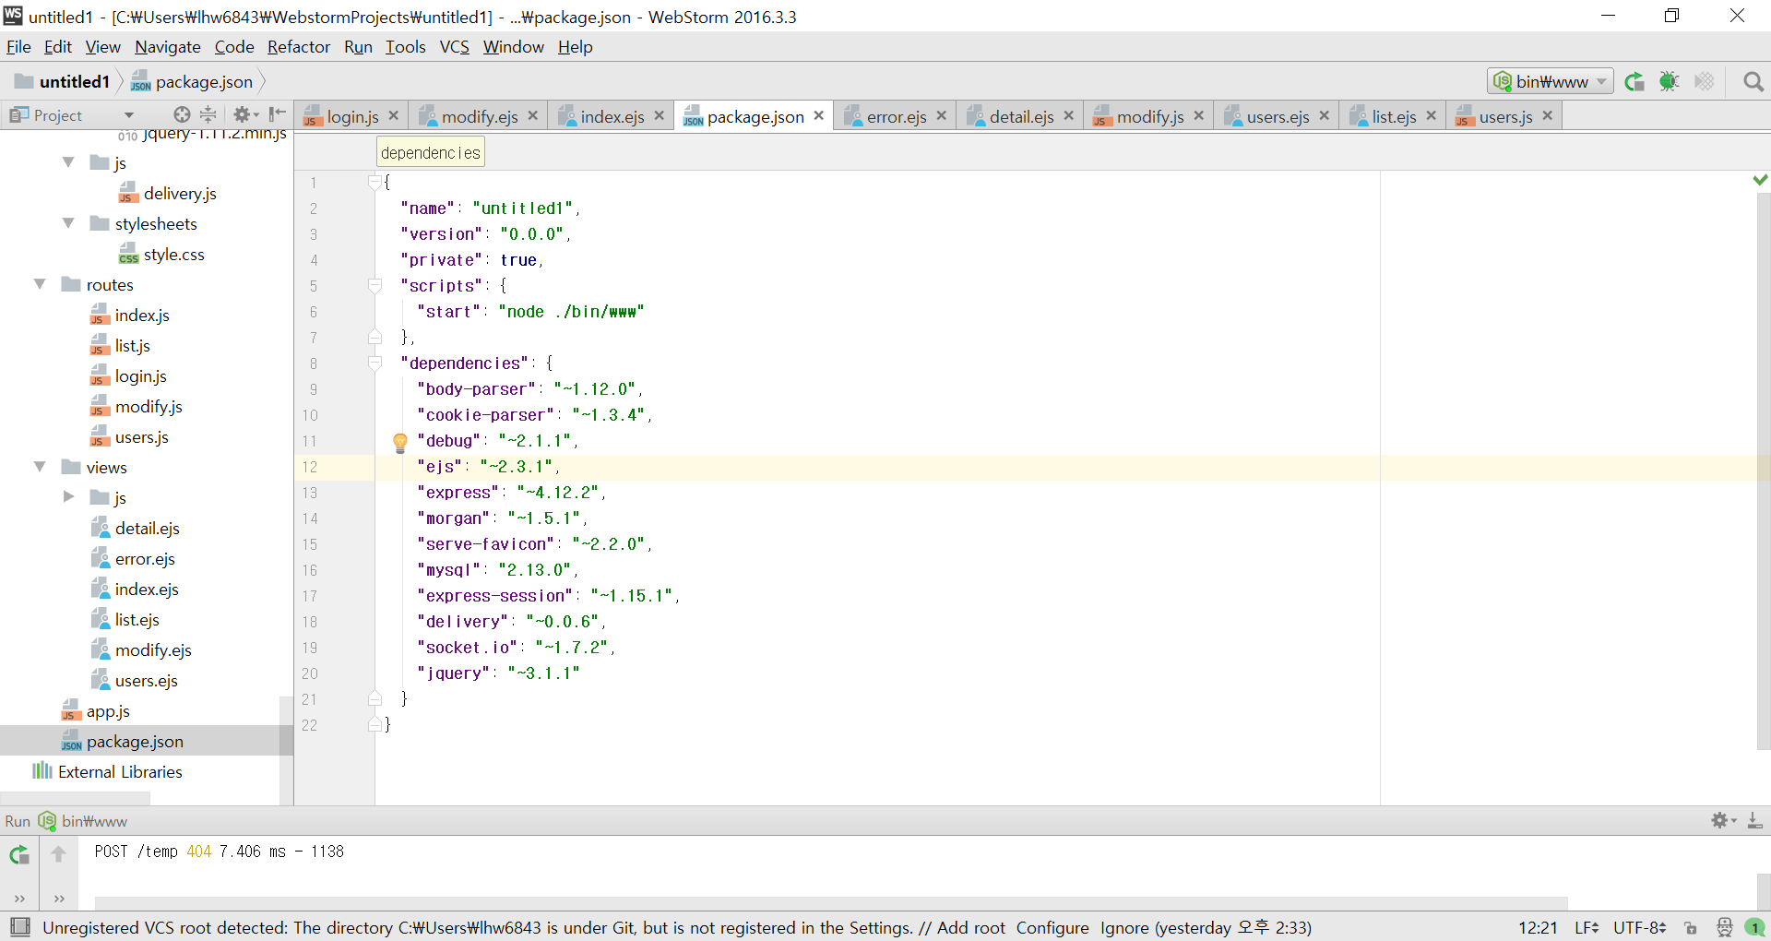
LIBRARY
06
Chapter\ 1
SOURCE FILE SOLUTION
01

Slide 21
Thank you

